Slide 1
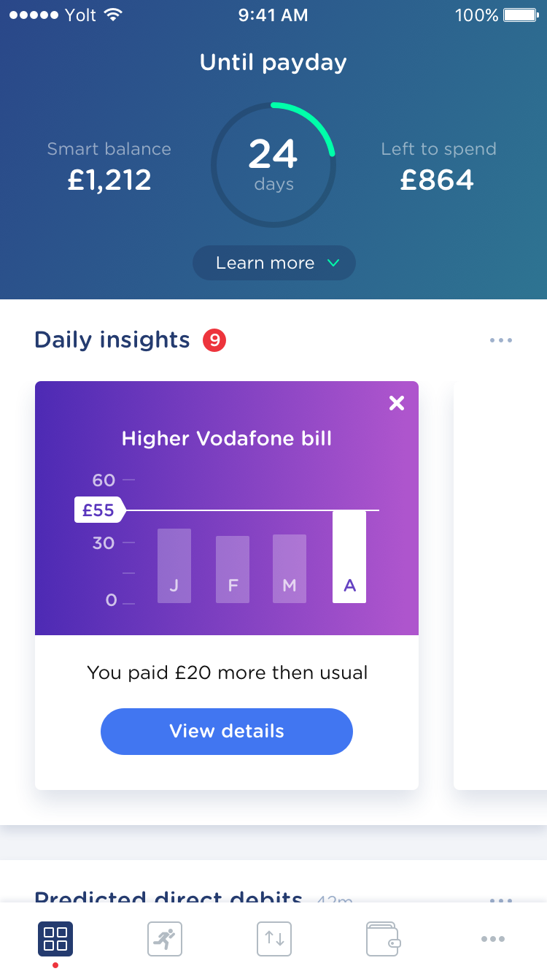
Gradle (Incremental) Things
Again

Slide 2
Agenda
What and why incremental builds
Modularisation and “dependencies, dependencies, dependencies”
Dagger Reflect
Moshi Reflect
Q&A
CatchUp

Slide 3
Incremental builds

Slide 4
Incremental builds
This is what happens majority of time on your dev machine
Smaller times are better productivity
Ideally should be matter of seconds with the small change

Slide 5
Modularisation and dependencies

Slide 6
Modules structure and dependencies
Build speed can be very dependent on your modules graph
Unused dependencies are making your debug app size bigger
Unused dependencies are making your builds potentially slower
It is nice to have everything clean and in control

Slide 7
Dependencies analysis plugin
https://github.com/autonomousapps/dependency-analysis-android-gradle-plugin
Unused dependencies which can be removed
Wrong configurations declared dependencies (api vs implementation)
Transitive dependencies that should be declared directly
Experimental: detect compileOnly dependencies

Slide 8
Dependencies analysis plugin
https://github.com/autonomousapps/dependency-analysis-android-gradle-plugin
The general philosophy of the plugin:
You should directly declare every dependency you use. Don’t rely on it being available transitively
You should correctly declare every dependency as implementation or api, depending on wether it is an implementation detail or part of ABI (binary API)

Slide 9
ABI == binary API
public class MyClass : MyOtherClass {}
MyClass is defined in module A, and MyOtherClass is defined in module B. Module A should declare api(project(":B")), because MyOtherClass is part of A's ABI

Slide 10
Dependencies analysis plugin
Limitations
Gives false positive if module depends on the resource
Gives false positive if module is not used in sources directly (LeakCanary)
Doesn’t work correctly with dynamic features (from my experience)

Slide 11
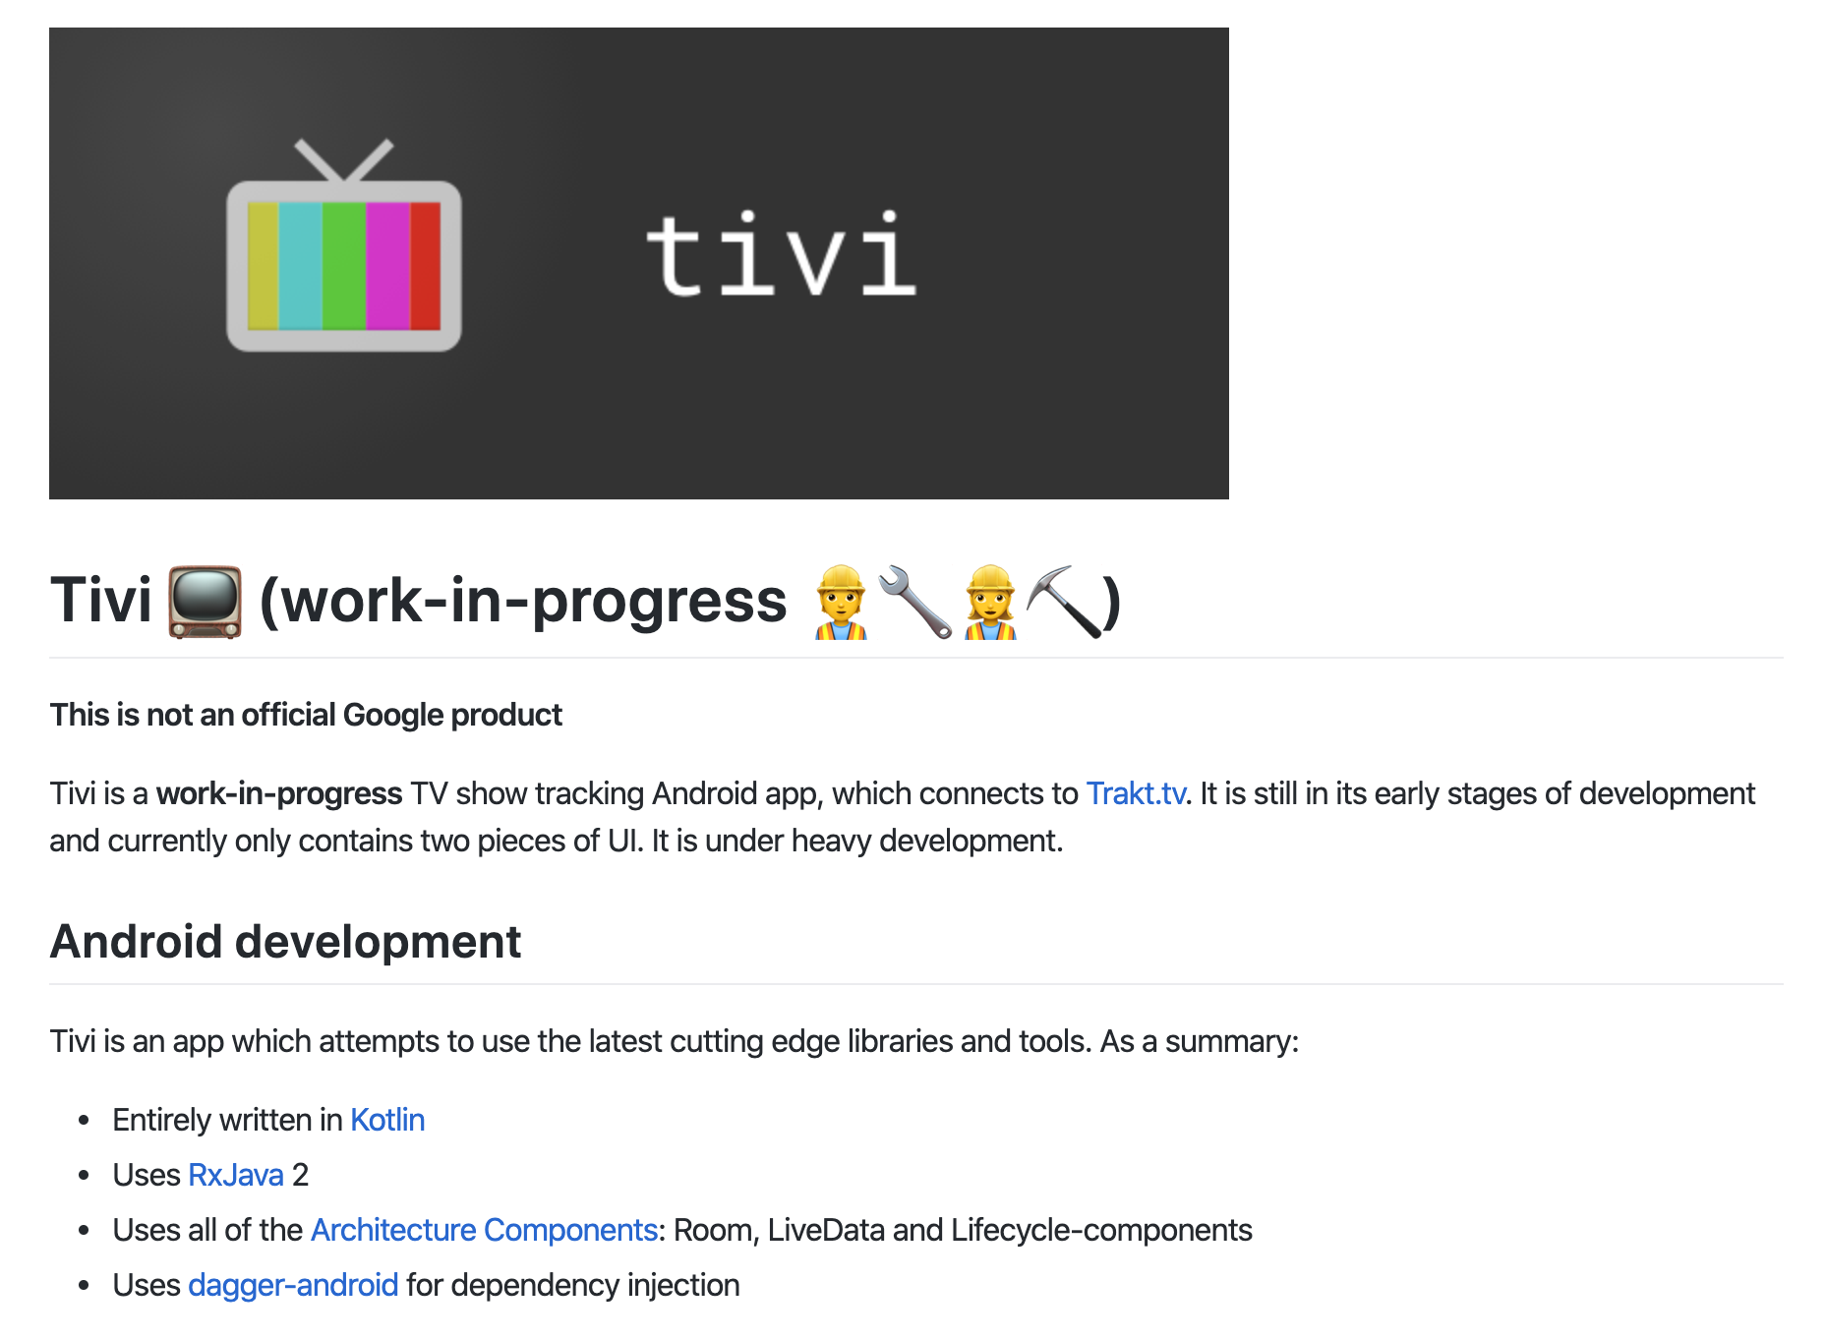
Tivi app
https://github.com/chrisbanes/tivi

Slide 12
Demo #1

Slide 13
Tivi app modules structure

Slide 14
Modules graph assert plugin
https://github.com/jraska/modules-graph-assert
Assert depth of the modules graph
Assert the correct dependencies order
Generate your graph picture

Slide 15
Modules graph assert plugin
https://github.com/jraska/modules-graph-assert
moduleGraphAssert {
maxHeight = 4
// modules prefixed with ":feature:" -> prefix ":lib:" -> prefix :core:
moduleLayers = [":feature:\\S*", ":lib\\S*", ":core\\S*"]
moduleLayersExclude = [":feature-about -> :feature-legacy-about”]
//regex to match module names
restricted = [':feature-[a-z]* -X> :forbidden-to-depend-on']
}

Slide 16
Demo #2

Slide 17
Can I drop jetifier?
https://github.com/plnice/can-i-drop-jetifier
Checks whether there are any dependencies using support library instead of AndroidX artifacts
Has own configuration
canIDropJetifier {
verbose = true // Default: false, set to true to print the dependencies tree down to the old artifact
includeModules = false // Default: true, print out not only external (library) dependencies, but also module dependencies that use old artifacts
analyzeOnlyAndroidModules = false // Default: true, analyze only modules that use com.android.application or com.android.library plugins
configurationRegex = ".*RuntimeClasspath" // Performance optimization: checks only configurations that match provided regex
parallelMode = true // Default: false, experimental: run analysis of modules in parallel
parallelModePoolSize = 4 // Default: max available processors - 1, experimental: pool size for analysis in parallel
}

Slide 18
Demo #3

Slide 19
Reflection instead of code generation

Slide 20
Dagger Reflection

Slide 21
Dagger Reflect
https://github.com/JakeWharton/dagger-reflect
Reflection based implementation of Dagger dependency library
Two ways of the integration
Doesn’t work with abstract classes - only interfaces are working
Component visibility should be always public
Doesn’t work with Producers

Slide 22
Dagger Reflect
Two ways of the integration
Partial
Doesn’t require code changes to switch between reflection and code generation
Still have small code generation part
Full
Requires code changes to have bridge
No code generation

Slide 23
Delect
https://github.com/soundcloud/delect
Uses partial Dagger reflect integration
Automatically changes dependencies for code generation to reflection version based on flag
Make sure you use @Component.Builder and @Component.Factory for components creation
Set retention police to RUNTIME for all @Qualifier and @MapKey annotations

Slide 24
Demo #4

Slide 25
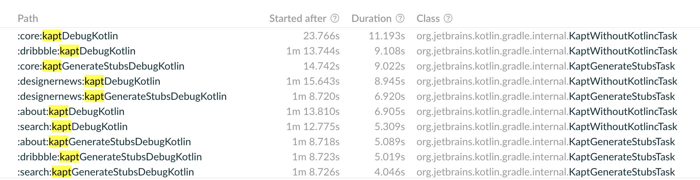
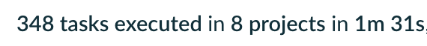
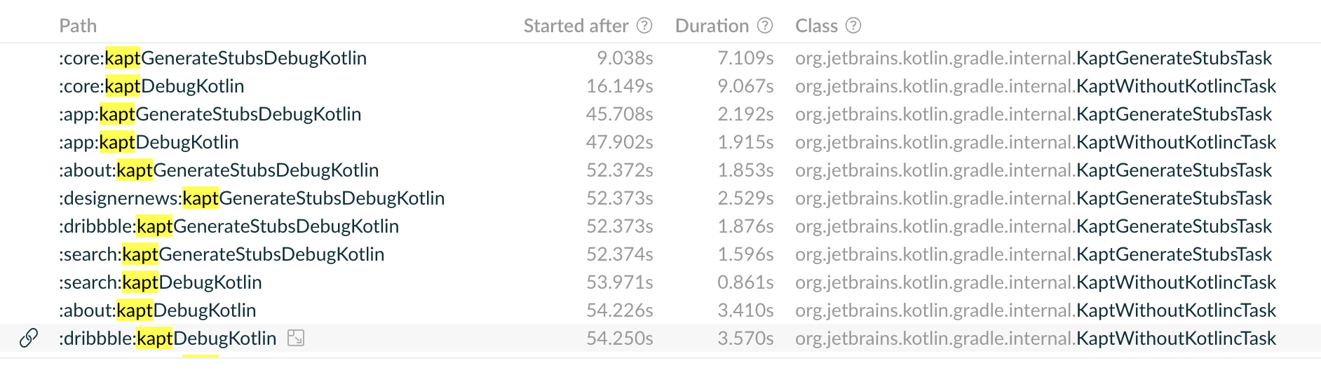
Numbers
How does it improve the build?

Slide 26
Moshi reflection

Slide 27
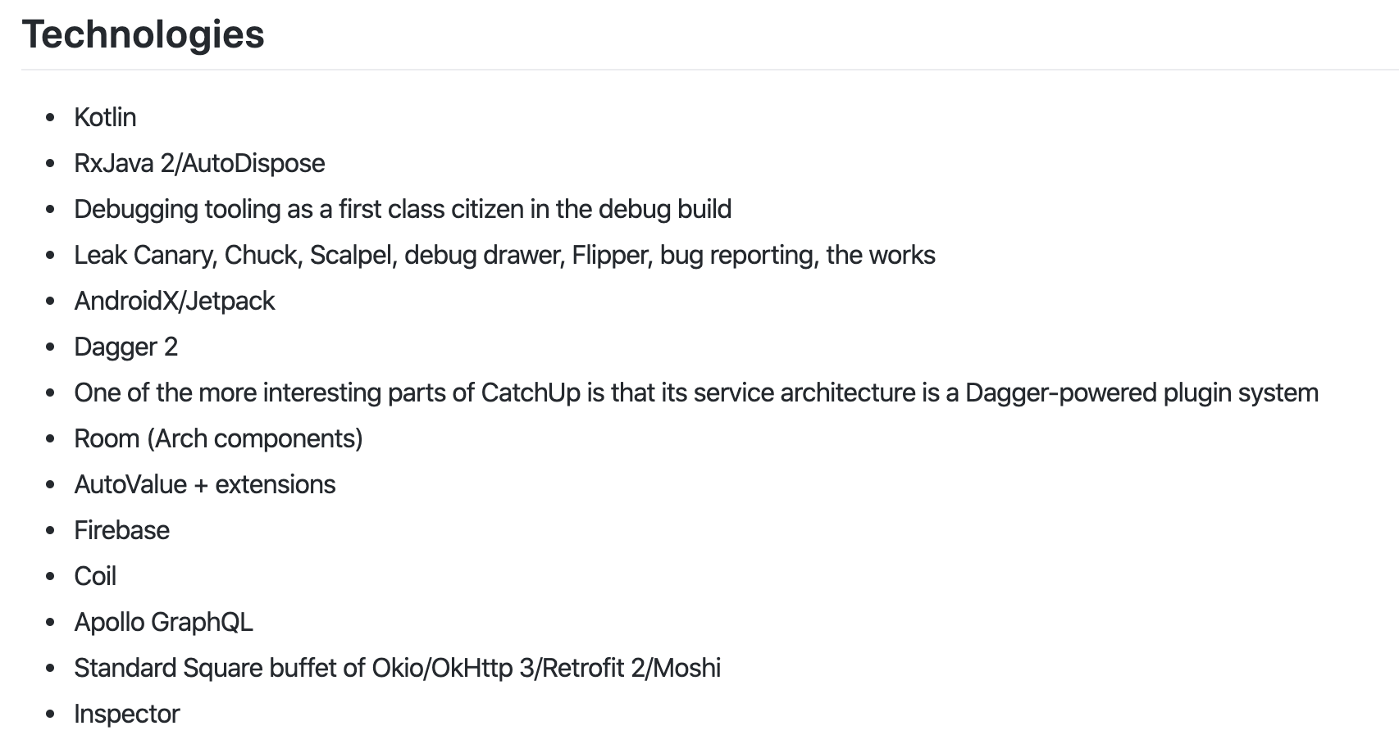
CatchUp
https://github.com/ZacSweers/CatchUp

Slide 28
Yolt
is hiring

Slide 29
Links
Dependencies analysis plugin (https://github.com/autonomousapps/dependency-analysis-android-gradle-plugin)
Graph assert plugin (https://github.com/jraska/modules-graph-assert)
“Can I drop jetifier” plugin (https://github.com/plnice/can-i-drop-jetifier)
Dagger reflect (https://github.com/JakeWharton/dagger-reflect)
Delect plugin (https://github.com/soundcloud/delect)
Nelson’s article about Deject (https://developers.soundcloud.com/blog/dagger-reflect)
CatchUp project (https://github.com/ZacSweers/CatchUp)
Tivi project (https://github.com/chrisbanes/tivi)
Plaid project (https://github.com/android/plaid)

Slide 30
Q&A
(Please)

